Slide 1

R.V.R. & J.C. COLLEGE OF ENGINEERING
Department of Computer Science and Engineering(Data Science)
Enhancing Employee Attrition Prediction Using Hybrid Machine Learning Models
Batch No - 20
K. Karthik - Y22CD071 N. Sai sumanth babu -Y22CD113 P. Jacob Abraham Jane -Y22CD122
Under the Guidance of
Mr. R.Ch.S.N.P.Sairam
Assistant Professor Dept of CSE(DS)

Slide 2
Table of Contents
Abstract
Problem Statement
Objectives
Literature Survey
Existing Model
Proposed Model
System Architecture
Implementation
Results
Conclusion
Future Scope

Slide 3
ABSTRACT
Employee attrition prediction is important for improving workforce stability and organizational performance. Traditional machine learning models often rely on single classifiers, face challenges with imbalanced data, and lack interpretability, which limits their effectiveness in real-world HR decision-making. To overcome these issues, this project proposes a hybrid machine learning framework that integrates SMOTE for class imbalance handling, Genetic Algorithm (GA) for feature selection, and an ensemble of LightGBM and CatBoost classifiers using a soft-voting approach to enhance predictive performance. Additionally, SHAP-based explainability is incorporated to identify key factors influencing employee attrition, enabling transparent, accurate, and data-driven decision-making in HR analytics.

Slide 4
Problem Statement
Employee attrition has become a major challenge for organizations in today’s competitive job market, as high workforce mobility leads to productivity loss, increased recruitment costs, and disruptions in overall performance. Traditional HR analytics struggle to capture the complex factors driving employee turnover, while existing machine learning models often depend on single classifiers, face issues with imbalanced data, and offer limited interpretability. Hence, there is a clear need for a robust, hybrid, and explainable machine learning approach that can accurately predict employee attrition and support informed HR decision-making.

Slide 5
Objectives
To develop an efficient hybrid machine learning model for employee attrition prediction
To handle class imbalance using SMOTE for better minority prediction
To apply Genetic Algorithm (GA) for selecting important features
To build an ensemble model using LightGBM and CatBoost for improved accuracy
To provide model explainability using SHAP for better decision-making
To support HR professionals with data-driven insights for employee retention

Slide 6
Literature Survey
Author & Year | Methodology | Dataset Used | key contributions | Limitation
Proposed Work (2026) | Hybrid ensemble framework integrating SMOTE for imbalance handling, GA-based feature selection, LightGBM + CatBoost (soft voting), and SHAP explainability | HR Analytics dataset | Improves prediction accuracy and robustness using ensemble learning, effectively handles class imbalance, enhances feature selection, and provides interpretable insights for attrition prediction | Performance depends on data quality; computational cost slightly higher due to ensemble model and GA optimization
Base Paper(Hojat, Amid & Vahid., 2025) | GA + LightGBM model | HR Analytics & Organizational datasets | Demonstrated that GA-based feature selection with LightGBM improves AUC and F1-score | Uses fixed global weights and lacks ensemble diversity and explainability
Ahmed (2023) | Neural Network–based classification model for employee turnover prediction | Organizational HR dataset | Demonstrated that neural networks can capture non-linear patterns in employee turnover and improve prediction accuracy | Lacks explainability; black-box nature makes HR decision-making difficult
Judrups et al. (2021) | Supervised ML models (Logistic Regression, SVM, Random Forest) | Organizational dataset | Compared multiple ML classifiers and highlighted Random Forest as a strong baseline model | Limited performance due to redundant features; no ensemble optimization
Jain & Nayyar (2018) | XGBoost-based machine learning model | IBM HR Analytics dataset | Showed that gradient boosting methods outperform logistic regression in predicting employee attrition | Does not address class imbalance; no feature selection or interpretability

Slide 7
Existing work
In existing paper Genetic Algorithm (GA) for optimal feature selection by eliminating redundant and irrelevant attributes. Effectively reduces feature dimensionality using GA-based optimization. LightGBM provides fast training and strong performance on structured HR data. Relies on a single classifier, limiting model diversity and robustness

Slide 8
Proposed Work
The proposed work uses SMOTE oversampling to effectively handle class imbalance and improve recall for minority attrition cases. It integrates Genetic Algorithm (GA) for feature selection and combines LightGBM and CatBoost classifiers using a soft voting ensemble to enhance prediction accuracy, robustness, and generalization. Additionally, SHAP is incorporated to interpret model predictions and identify key factors influencing employee attrition, enabling transparent and data-driven HR decision-making.

Slide 9
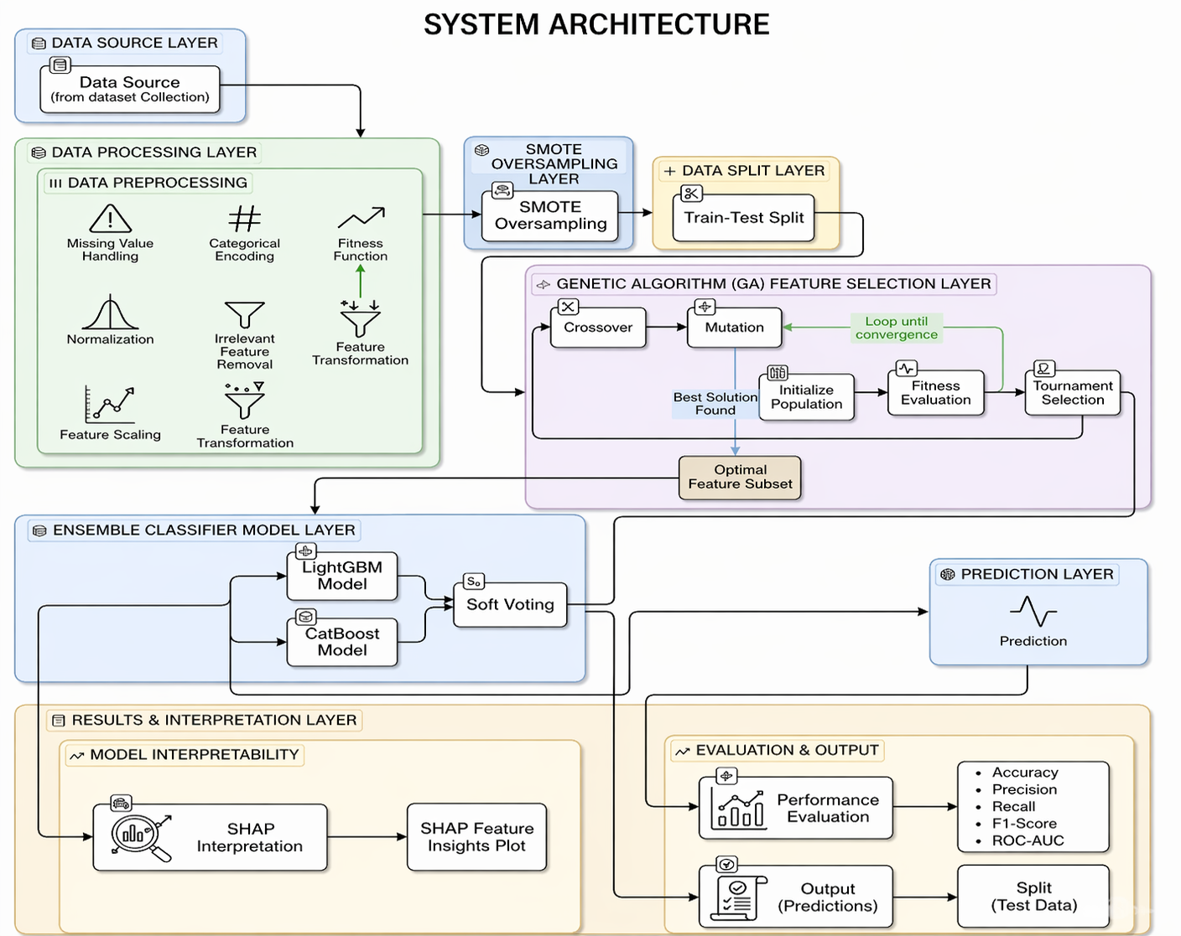
System Architecture

Slide 10
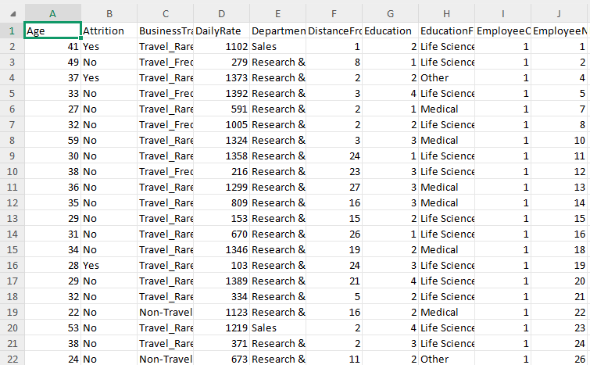
Dataset Used
This project uses a publicly available employee attrition dataset comprising demographic and job-related attributes. Preprocessing includes categorical encoding, feature scaling, and removal of irrelevant features. SMOTE is applied to resolve class imbalance, followed by stratified train-test splitting. The processed data is used to train a hybrid ensemble model combining LightGBM and CatBoost using a soft-voting approach, along with SHAP-based explainability to interpret predictions.

Slide 11
Implementation
Dataset: HR Analytics dataset (Employee attrition data)
Data Preprocessing: Missing value handling, Label Encoding, Normalization, and SMOTE for class balancing
Dataset Split: 80% training and 20% testing (stratified split)
Feature Selection: Genetic Algorithm (GA) to select optimal features
Base Models: LightGBM and CatBoost classifiers
Ensemble Method: Soft voting to combine predictions from both models
Model Evaluation: Accuracy, Precision, Recall, F1-score, and ROC-AUC
Explainability: SHAP used for feature importance and prediction interpretation

Slide 12
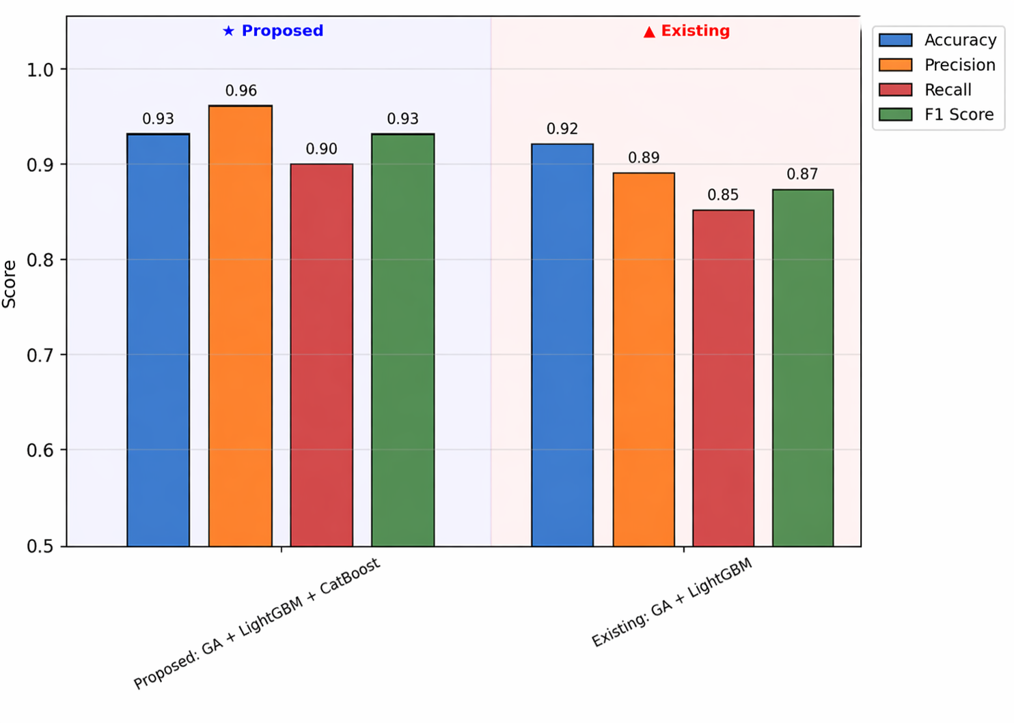
Results
The proposed hybrid model (GA + LightGBM + CatBoost) shows improved performance compared to the existing model.
Achieved higher Accuracy (93%) compared to 92% in existing model.
Significant improvement in Precision (96%) and Recall (90%), leading to better detection of attrition cases.
The F1-score also increased to 93%, indicating balanced performance across classes.
Overall, the ensemble approach provides better stability and reliable predictions.

Slide 13
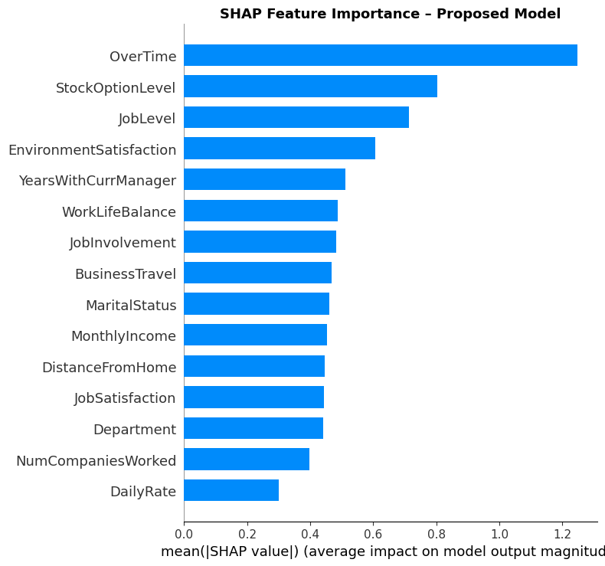
Explainability (SHAP)
SHAP analysis is used to interpret the model’s predictions and identify important features.
The graph shows the top factors influencing employee attrition.
OverTime, StockOptionLevel, and JobLevel are the most important features affecting predictions.
Features like EnvironmentSatisfaction, WorkLifeBalance, and MonthlyIncome also contribute significantly.
SHAP helps in understanding how each feature impacts attrition, improving model transparency.

Slide 14
Conclusion
Developed an efficient hybrid ML model for attrition prediction
Successfully handled class imbalance using SMOTE
GA improved feature selection and model efficiency
Ensemble model improved accuracy and generalization
SHAP provided transparent and explainable predictions
System supports data-driven HR decision-making

Slide 15
Future Scope
Development of a real-time employee attrition prediction system
Integration with web-based or enterprise HR platforms
Use of deep learning or advanced hybrid models for improved accuracy
Application on larger and multi-domain datasets for better generalization
Enhancement of explainability using advanced XAI techniques
Deployment as a decision-support tool for HR management

Slide 16
Thank You

